Slide 1

Chass Complaint Handler Assitance
Colour F7921E
Get closer with your customer

Slide 2


Our Team
Wahyudi, S.Kom.
Enggar Kristian, S.T.

Slide 3
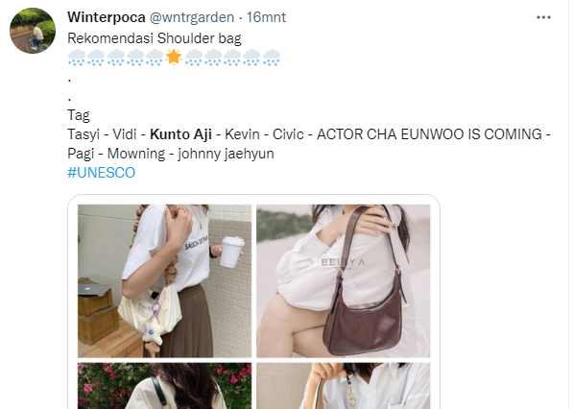
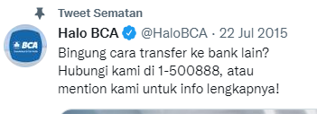

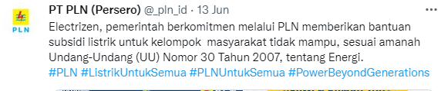
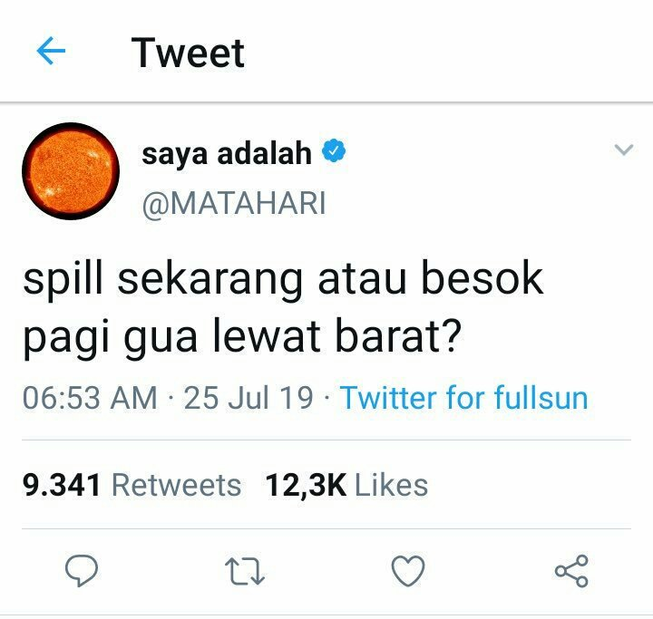
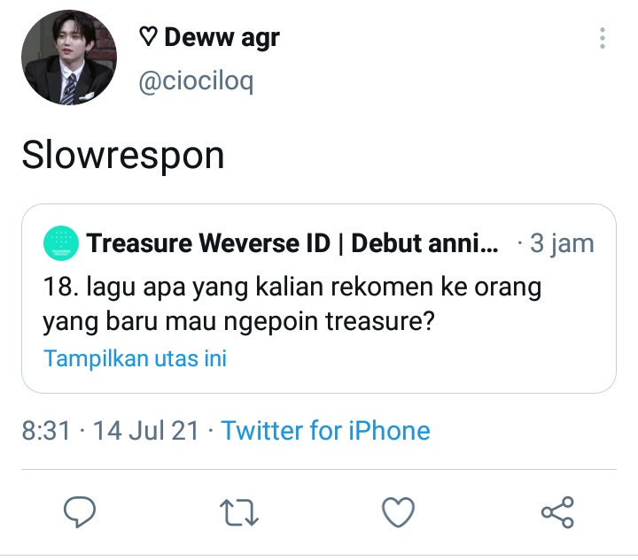
Background
Positive Side:
Negative Side:
Information era

Slide 4
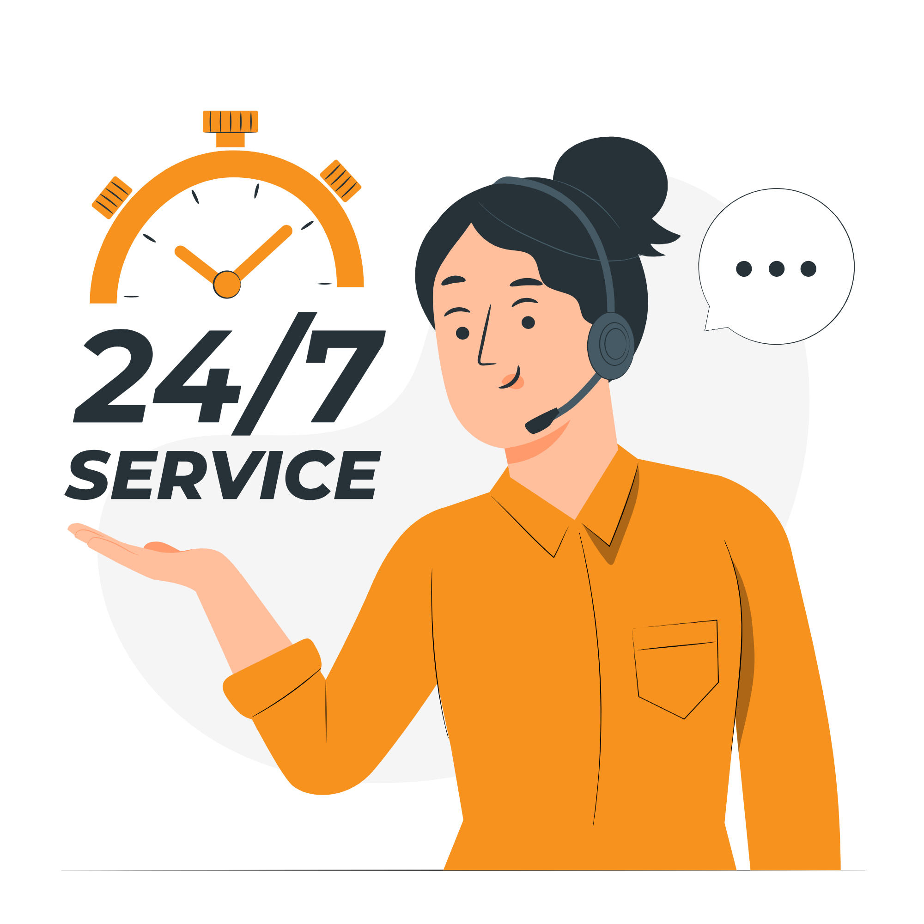
Service is everything
Good Service is Good Business
Stay Calm and Handle Their complain
understand customer concerns
Closer with the customer

Slide 5

Timeline
Advanced development (at future)
Improvement App
Implement To Twitter API
Create Model
Study Analysis

Slide 6
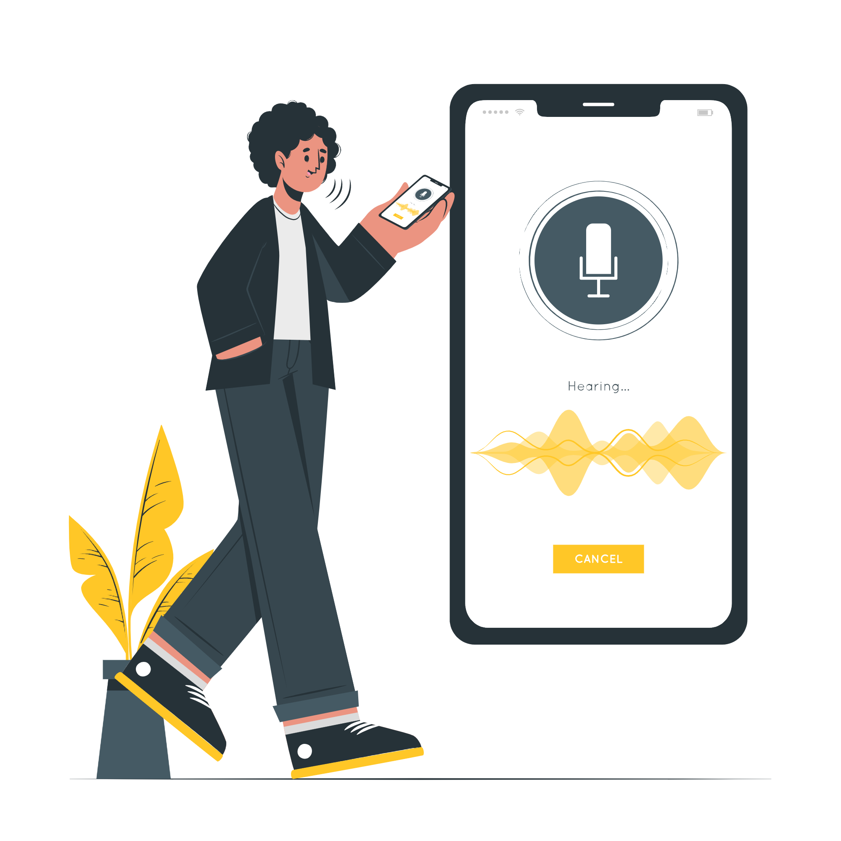
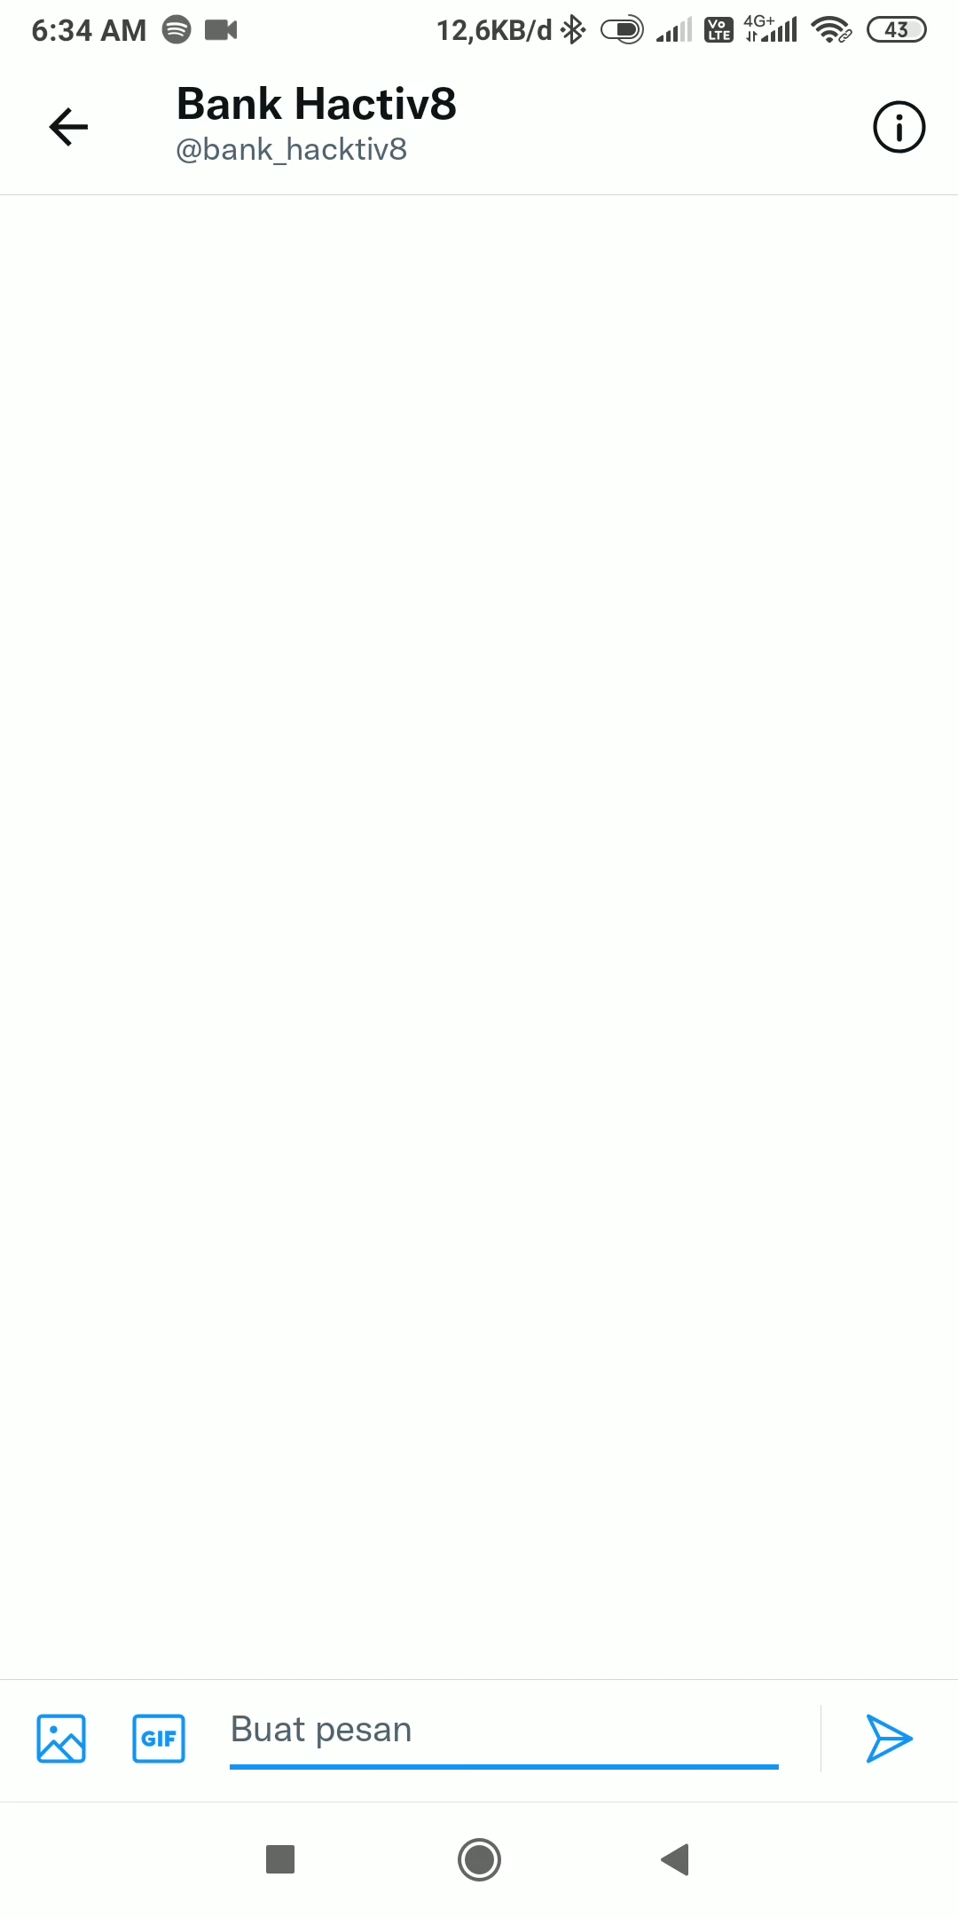
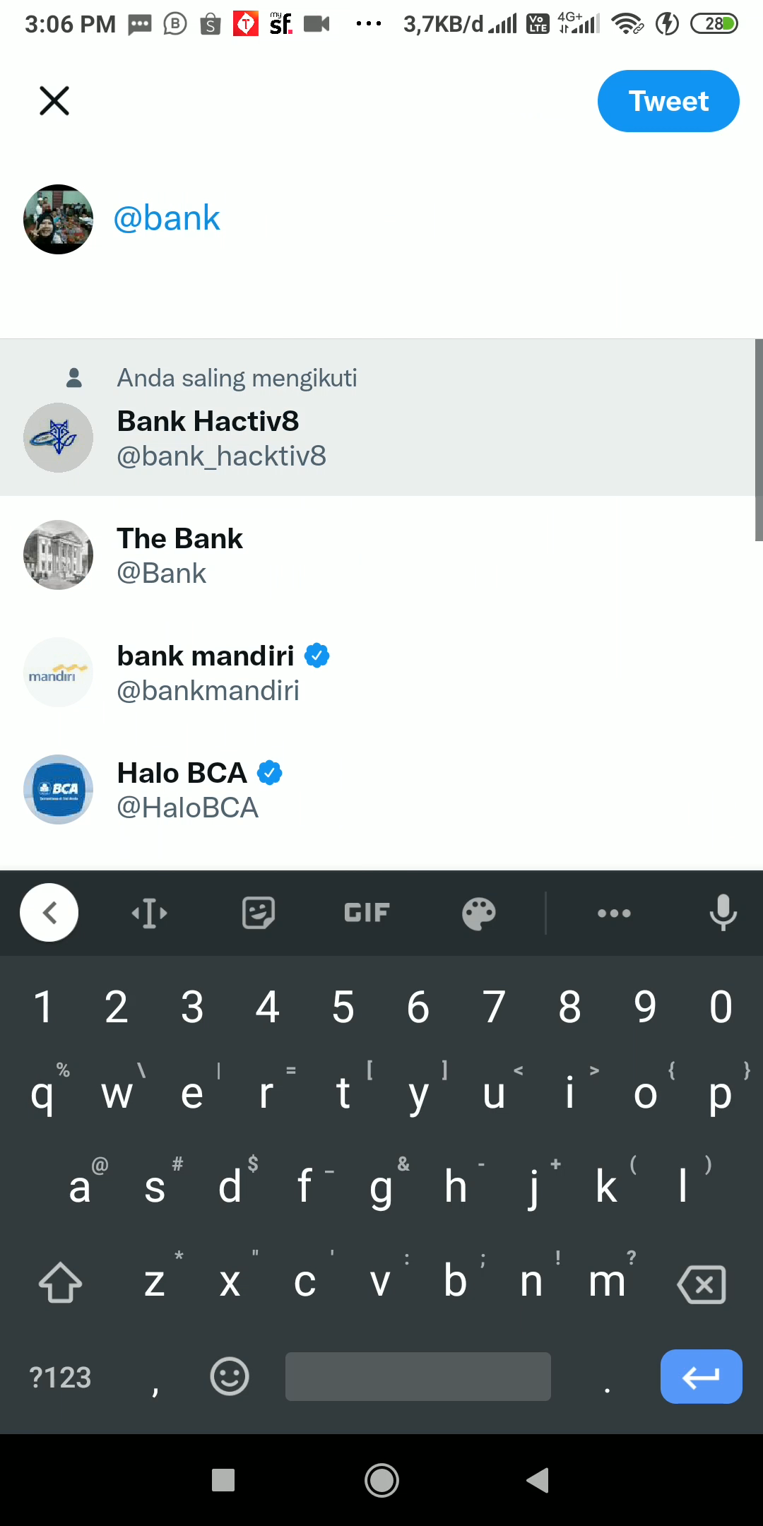
Fitur:
Reply Negative sentiment tweet
Chatbot
Limitation:
Long process
There are 13 informative issues and 1 procedural issue that can be handled
No session yet

Slide 7

Our Chalenge
Create dataset by self
Got The access from twitter
Learn twitter API
complete additional challenges from buddy

Slide 8

Future Improvement
Public perception dashboard
Implement to other platform
Emotional detection
Event analysis

